Slide 1
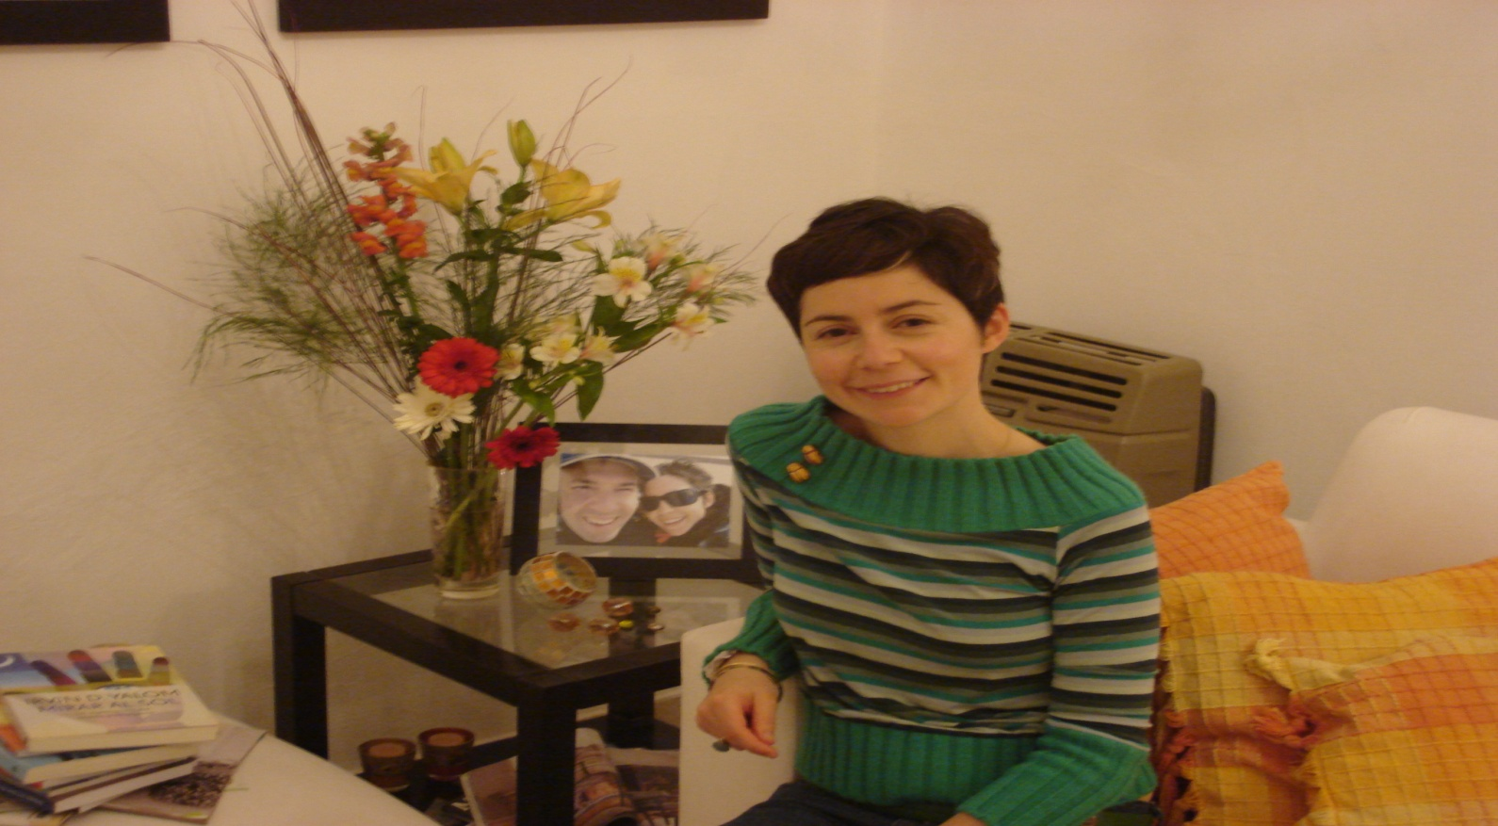
Mariana Serra- Argentina

Slide 2
things about me…

Slide 3
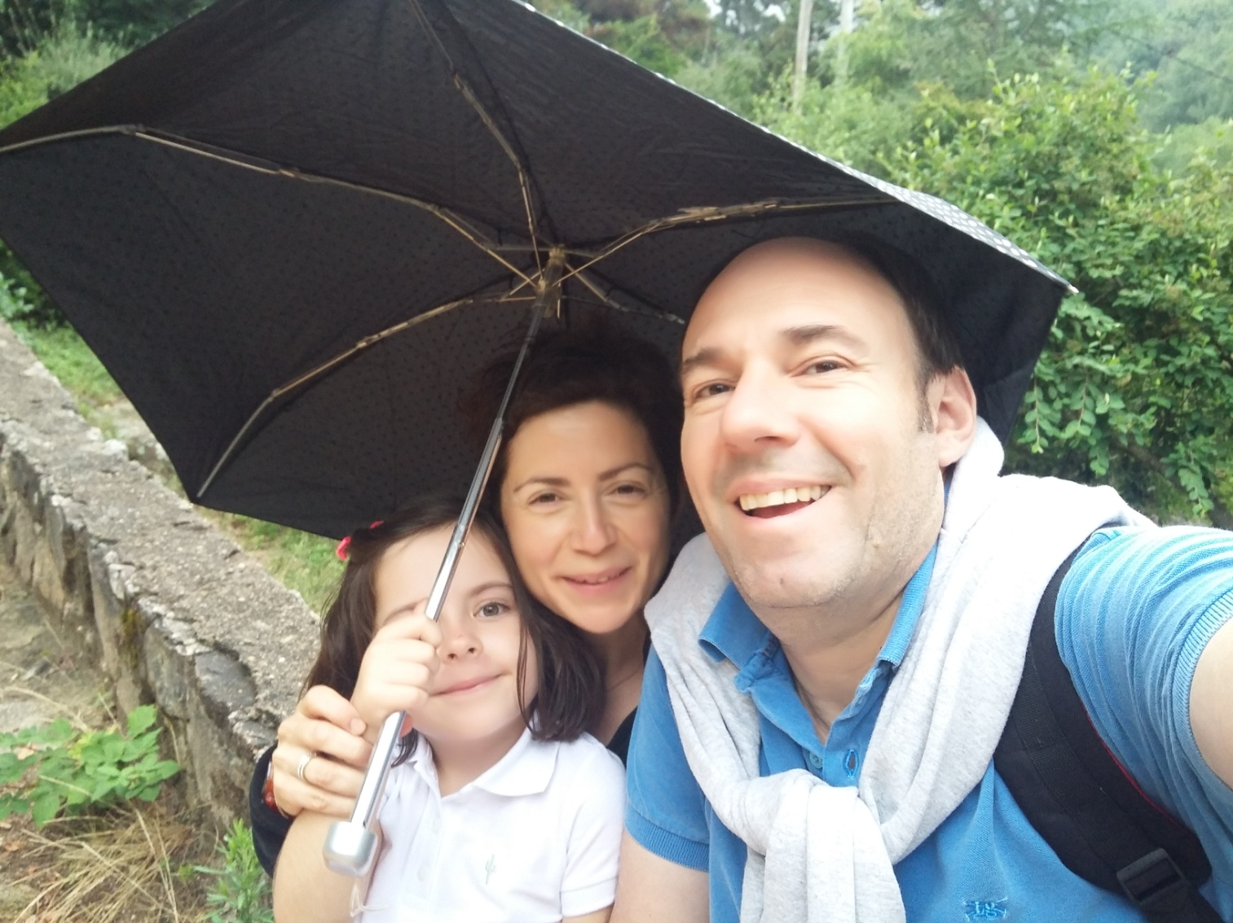
I LOVE my family

Slide 4
reading is one of my favourite
activities and…

Slide 5
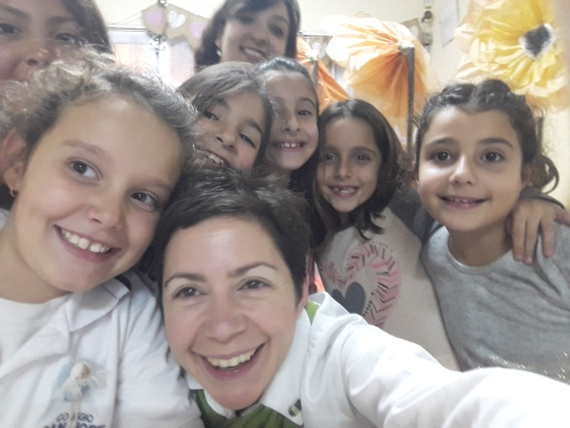
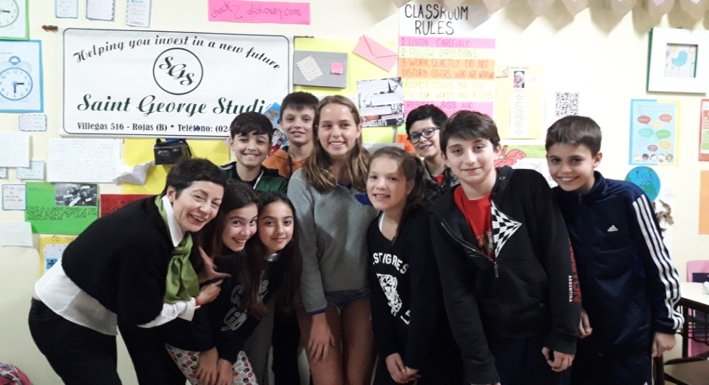
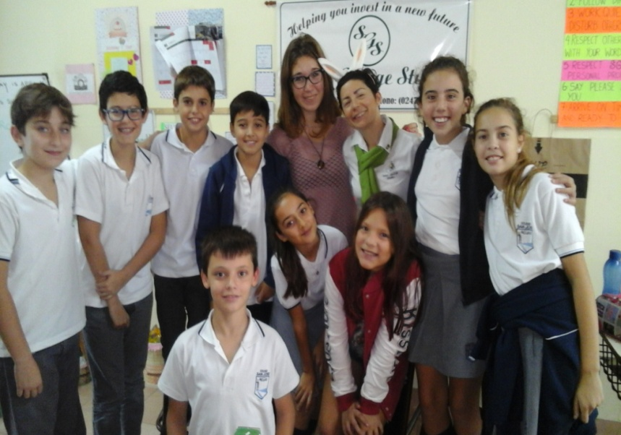
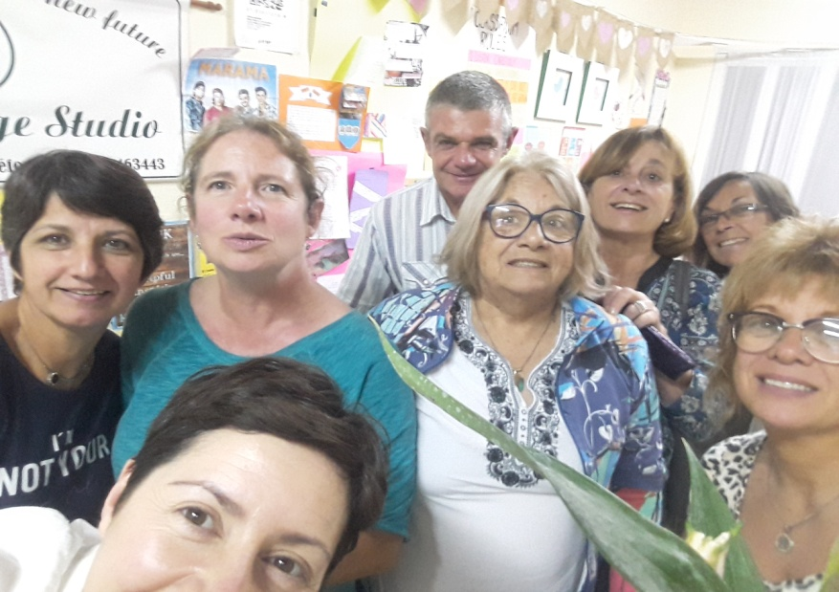
I LOVE teaching!

Slide 6
things I love doing when
I’m not teaching…

Slide 7
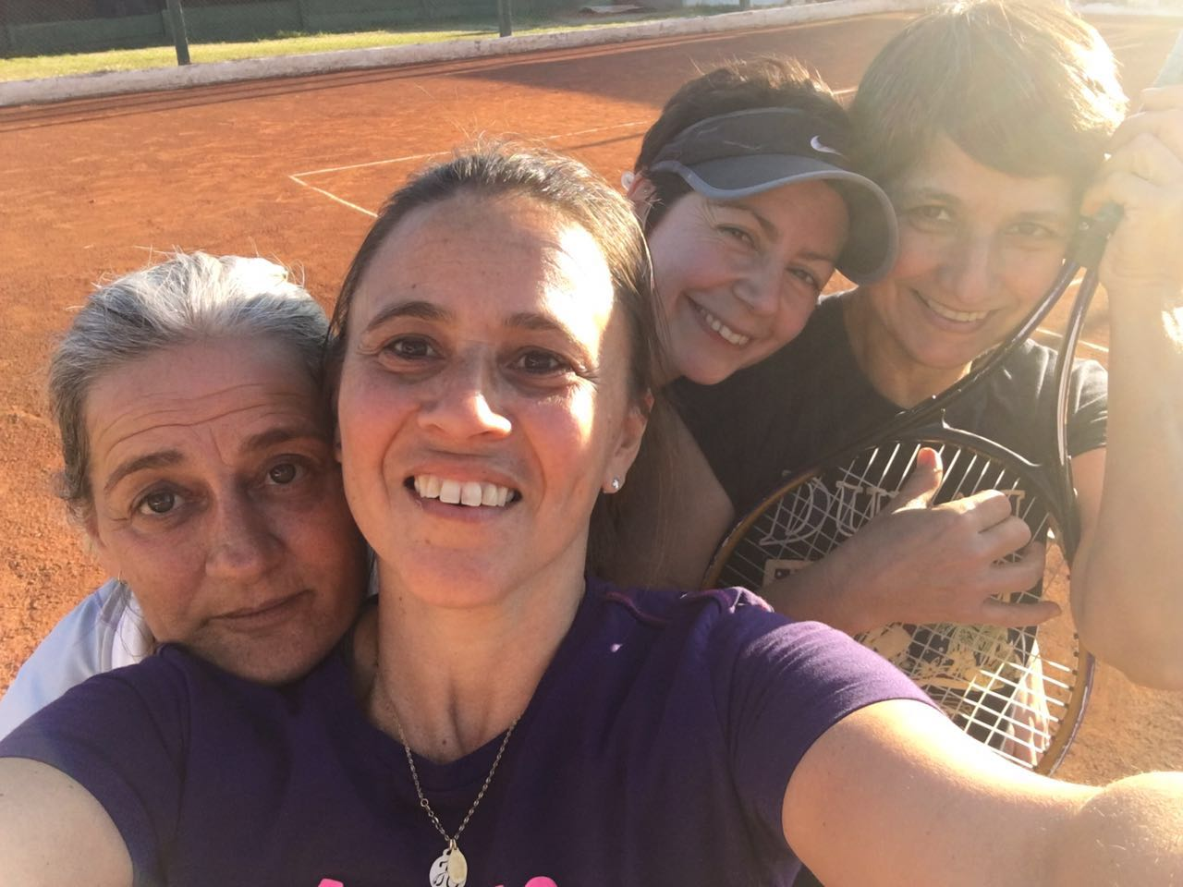
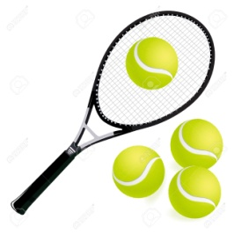
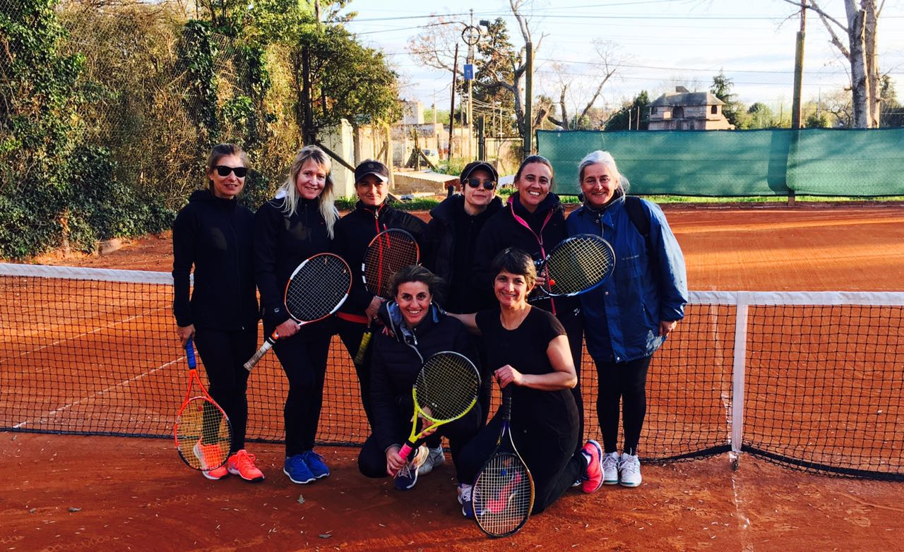
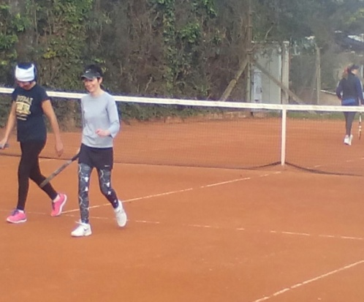
playing tennis…

Slide 8
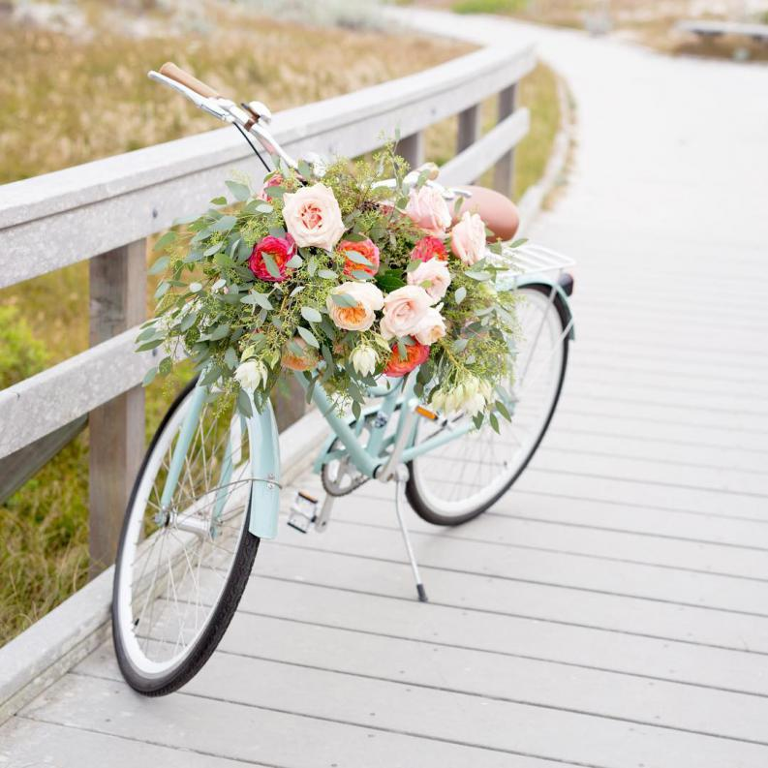
and riding my bike!

Slide 9
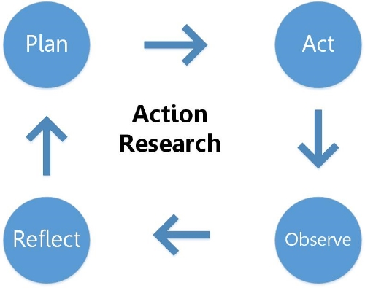
1 thing I’m curious about
and I’d like to continue researching is

Slide 10
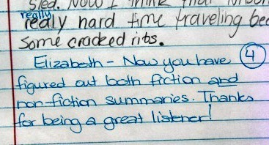
The effectiveness of formative T-written feedback
on the rewrites of EFL learners

Slide 11
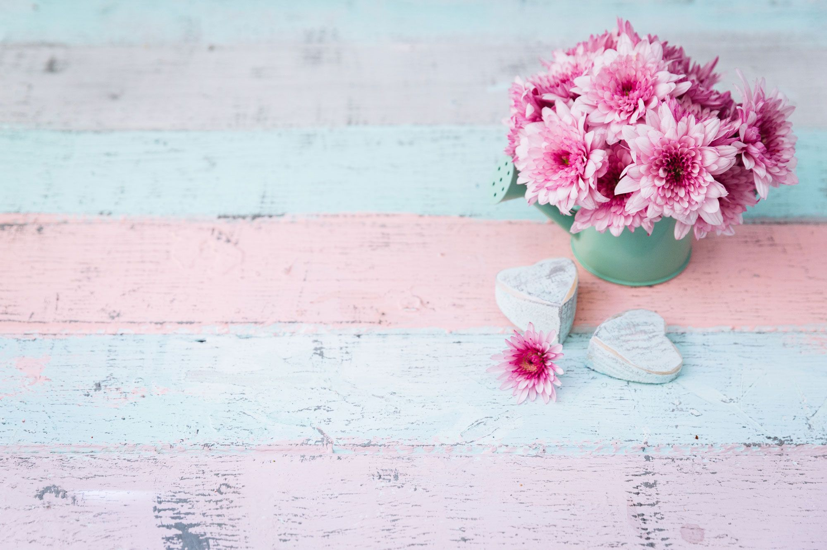
Can’t wait to meet you all!

